Slide 1
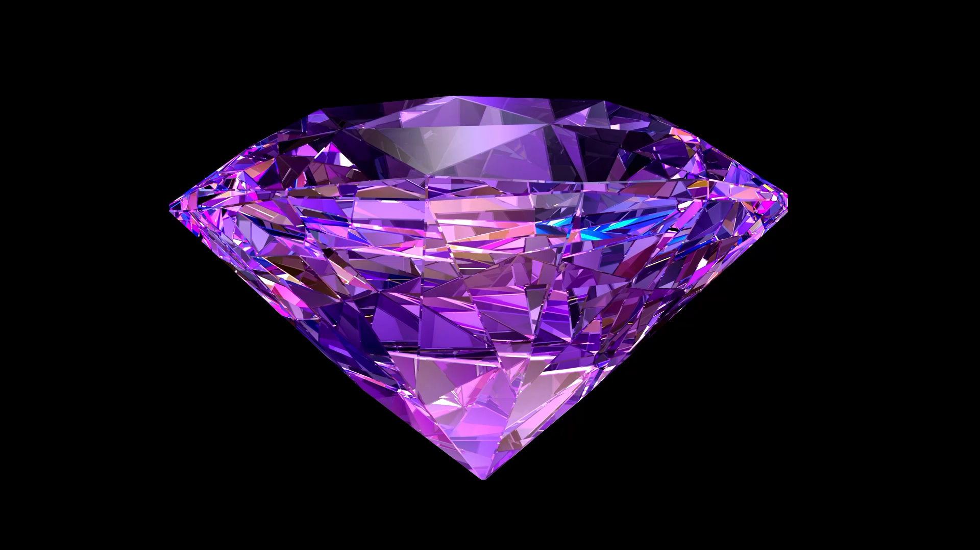
Diamonds
Machine Learning
Suzy Jones

Slide 2
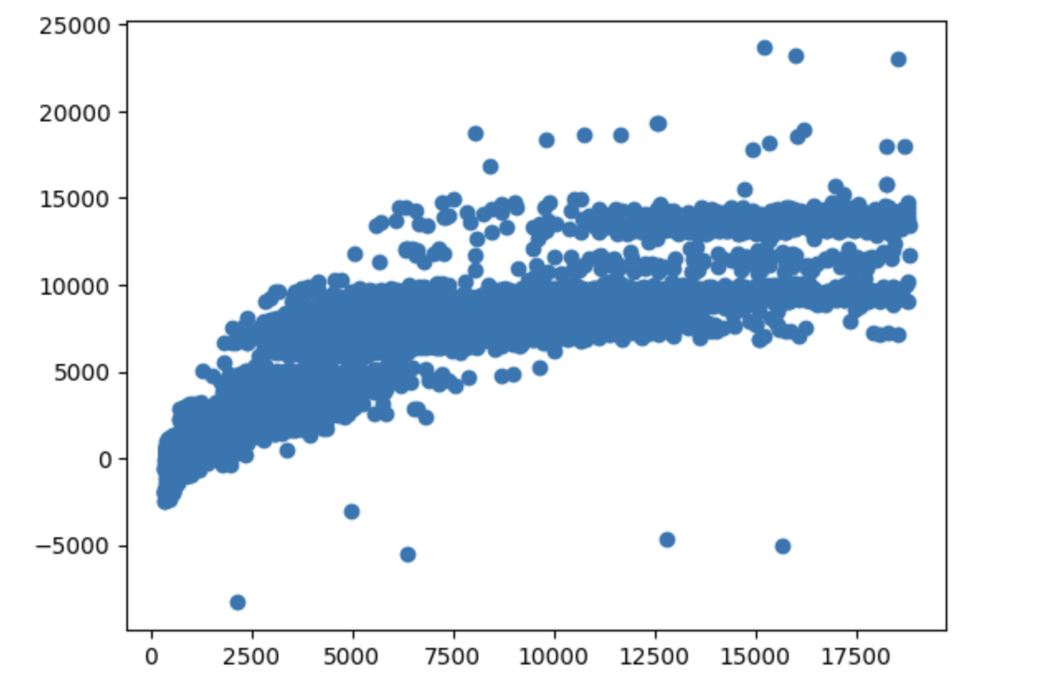
Relationship between price of diamonds and their carat, cut, clarity, depth, color, and table… It can be concluded the higher the carat, the clearer the clarity and color, the greater the depth; the higher the price. Based on this table of data, most diamonds seem to fall between $5,000 and $15,000.

Slide 3
Accuracy of Predictions:
Score: 0.8229019438618415
This means the predictions are 82% accurate… This is good news!

